Slide 1

SAFETY IMPROVEMENTS FOR SR 112/ARTHUR GODFREY ROAD
From Alton Road to West of Pine Tree Drive
Prepare By: Relative Point Engineering Inc.
April 28th, 2017

Slide 2

About The Customer
The Florida Department of Transportation (FDOT or Department) is an executive agency, which means it reports directly to the Governor.
FDOT’s primary responsibility is to coordinate the planning and development of a safe, viable, and balanced state transportation system serving all regions of the state

Slide 3
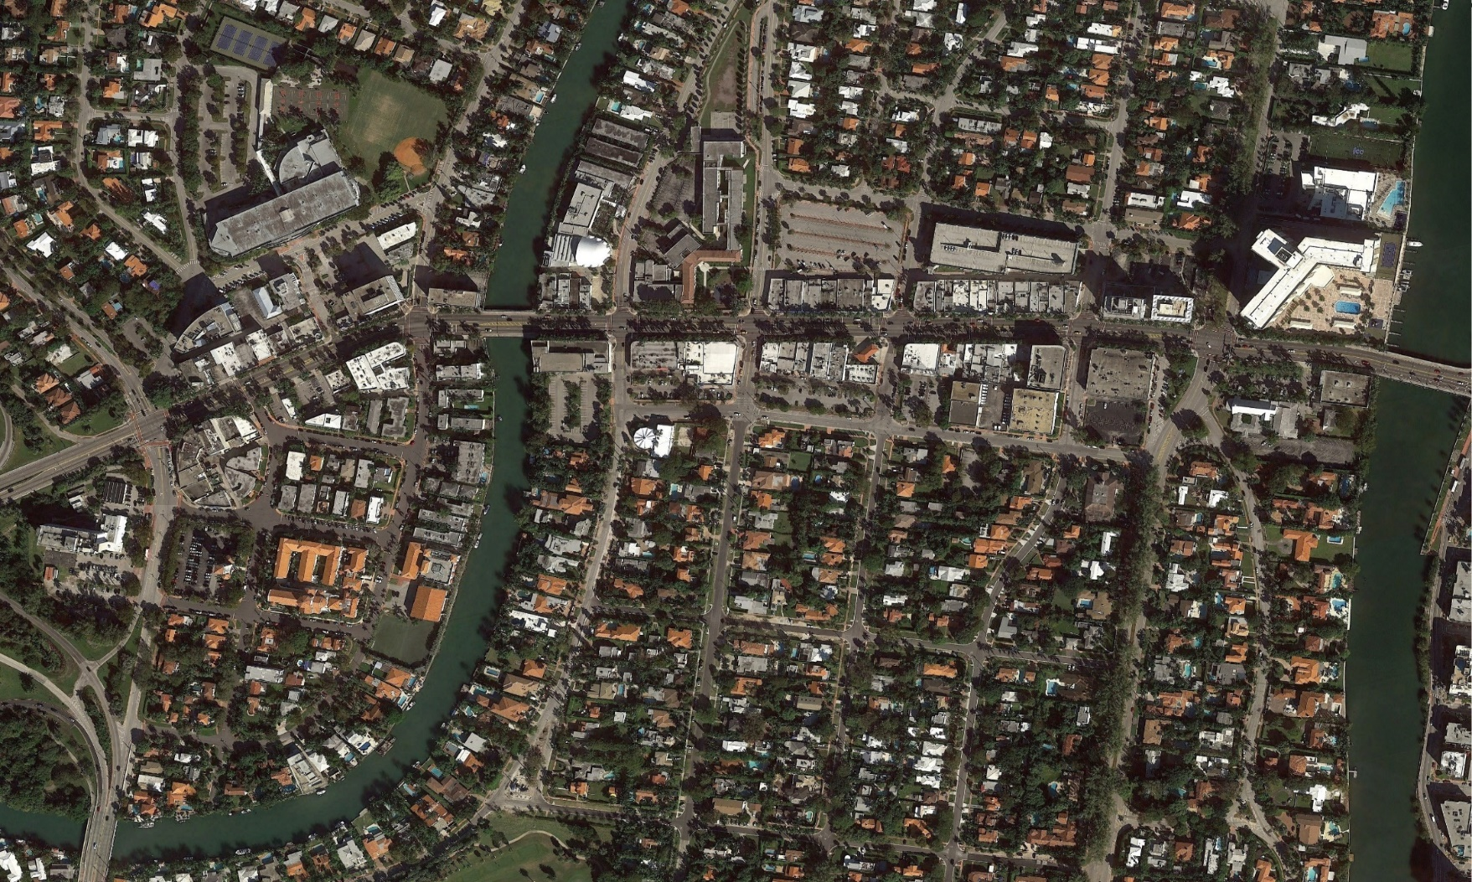
Introduction
SR-112 is a two-lane two-way roadway with a left-turn lane.
Highly transited roadway with approximately 41,000 ADT.
In a 3-year period from 2011 to 2014, this roadway experienced a high number of crashes.
N
Jefferson Ave
Meridian Ave
Chase Ave
Prairie Ave
Sheridan Ave
Pine Tree Dr
Royal Palm Ave
Alton Road
Garden Ave
SR 112/Arthur Godfrey Rd from Alton Rd to Pine Tree Dr

Slide 4
Problem Statement
A total of 307 crashes for 3-years period from 2011 to 2014 for the project segment
Alton Rd segment - 36 crashes
Garden Avenue segment - 19 crashes
Jefferson Avenue segment - 19 crashes
Meridian Avenue segment - 25 crashes
Chase Avenue segment – 38 crashes
Prairie Avenue segment– 44 crashes
Royal Palm Avenue segment – 61 crashes
Sheridan Avenue segment – 65 crashes

Slide 5

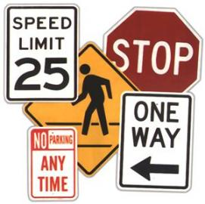
Scope
Safety project to reduce all types of crashes.
Safety study to determine the causes of the crashes and propose the required improvements to mitigate the crashes.
Design of the recommended Roadway improvements.
Design of the recommended Signalization improvements.
Design of the recommended Signing and Pavement Markings improvements.

Slide 6
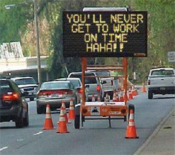
Project Significance
Safety Improvements could result in a crash reduction of approximately 60% of the crashes per year.
Pedestrian ways improvement will benefit this area of Miami Beach, which is heavy in pedestrian and bicycle traffic.
Additional benefits will be reflected in the reduction of rush hour traffic due to the signalization improvements.

Slide 7
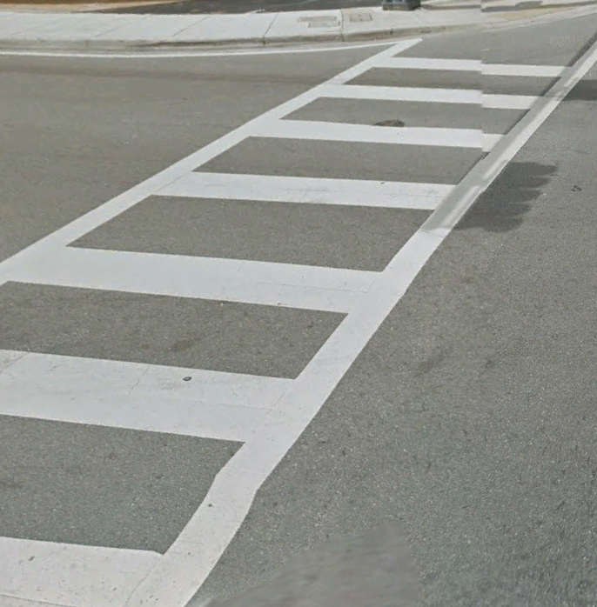
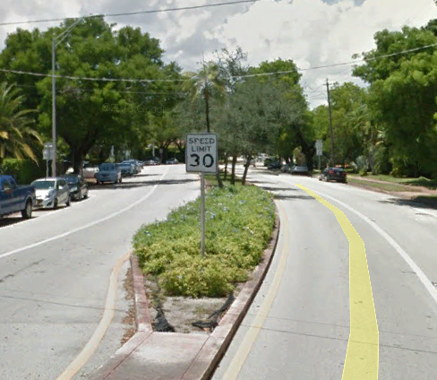
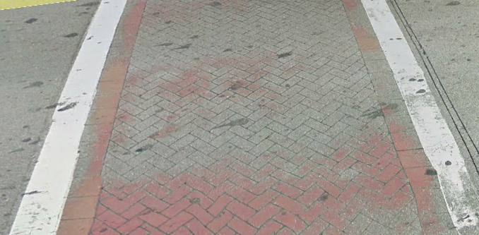
Proposed Approach
New raised landscaped median for uncontrolled pedestrian crossings.
High emphasis crosswalk for driver awareness due to large volume of pedestrians (including schools).
Signalization and Signing & Pavement Markings improvements (for safety).
Proposed High Emphasis
Raised Landscaped Median to discourage uncontrolled pedestrian crossings
Existing
Crosswalk

Slide 8
Work Breakdown Structure
1.0 Safety Improvements for State Road 112
2.1 Safety Study Phase
3.1 Design Phase
4.1 Construction Phase
2.1.1 Existing Conditions Evaluation
2.1.2 Proposed Improvements
2.1.3 Benefit-Cost Analysis
3.1.1 Design Plans
3.1.2 Cost Estimate
3.1.3 Specifications
4.1.1 Construction Schedule
4.1.2 Procurement
4.1.3 Construction

Slide 9
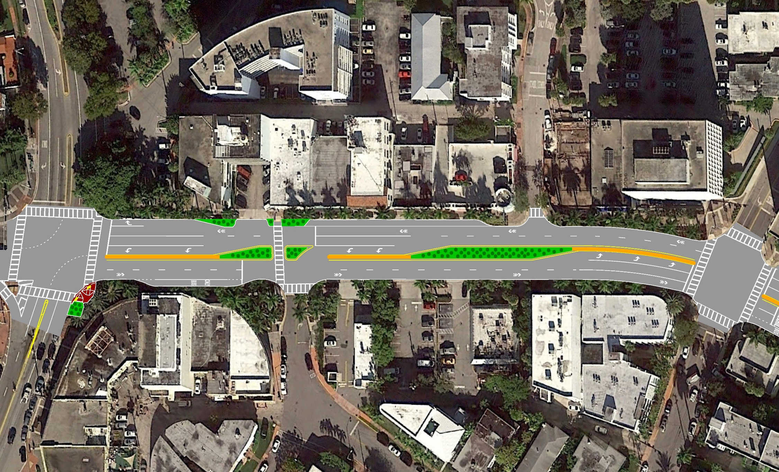
Preliminary Proposed Improvement Alton Road to Meridian Avenue

Slide 10
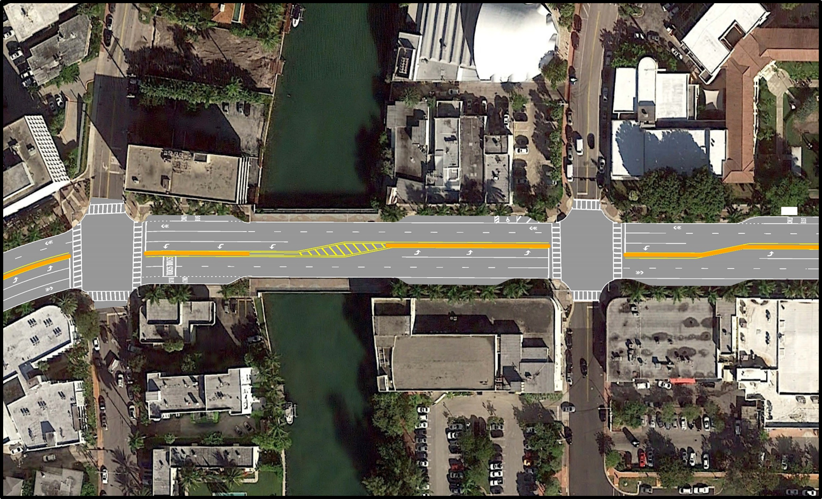
Preliminary Proposed Improvements Meridian Avenue to Chase Avenue

Slide 11
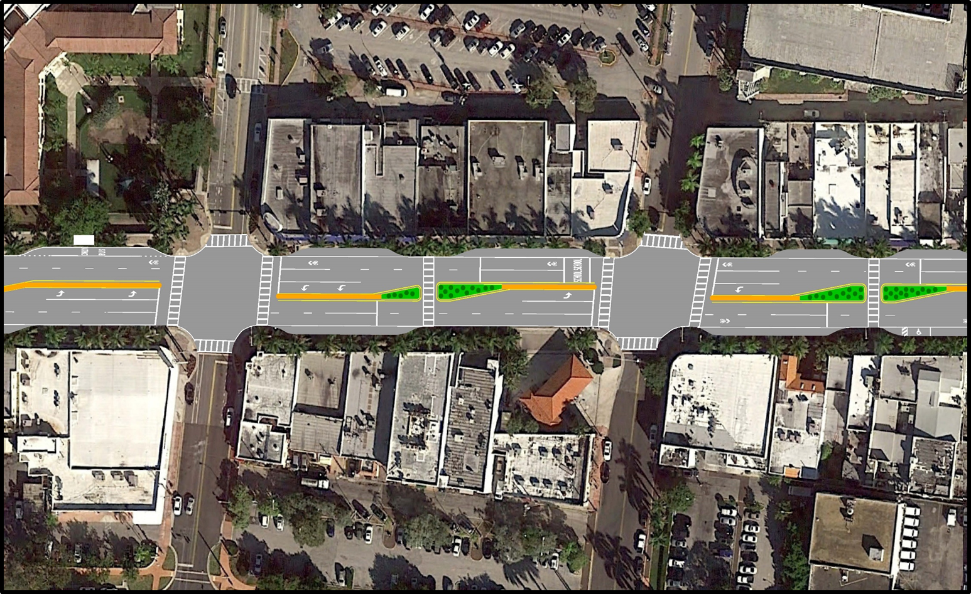
Preliminary Proposed Improvements Chase Avenue to Royal Palm Avenue
Relocated Bus Shelter

Slide 12
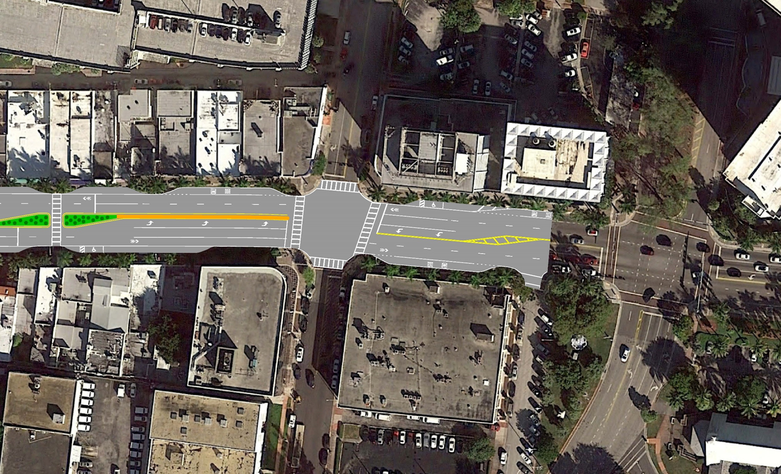
Preliminary Proposed Improvements Royal Palm Avenue to Pine Tree Drive

Slide 13
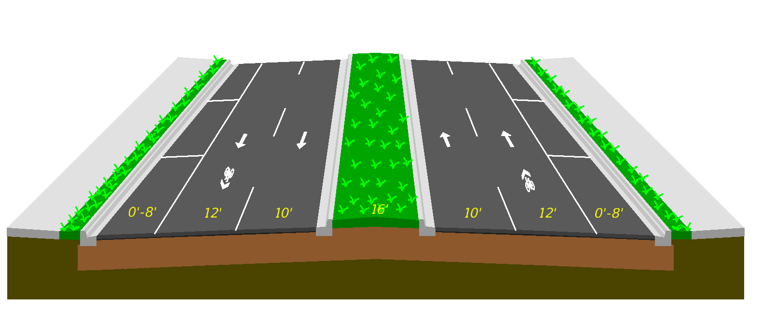
Preliminary Typical Section

Slide 14
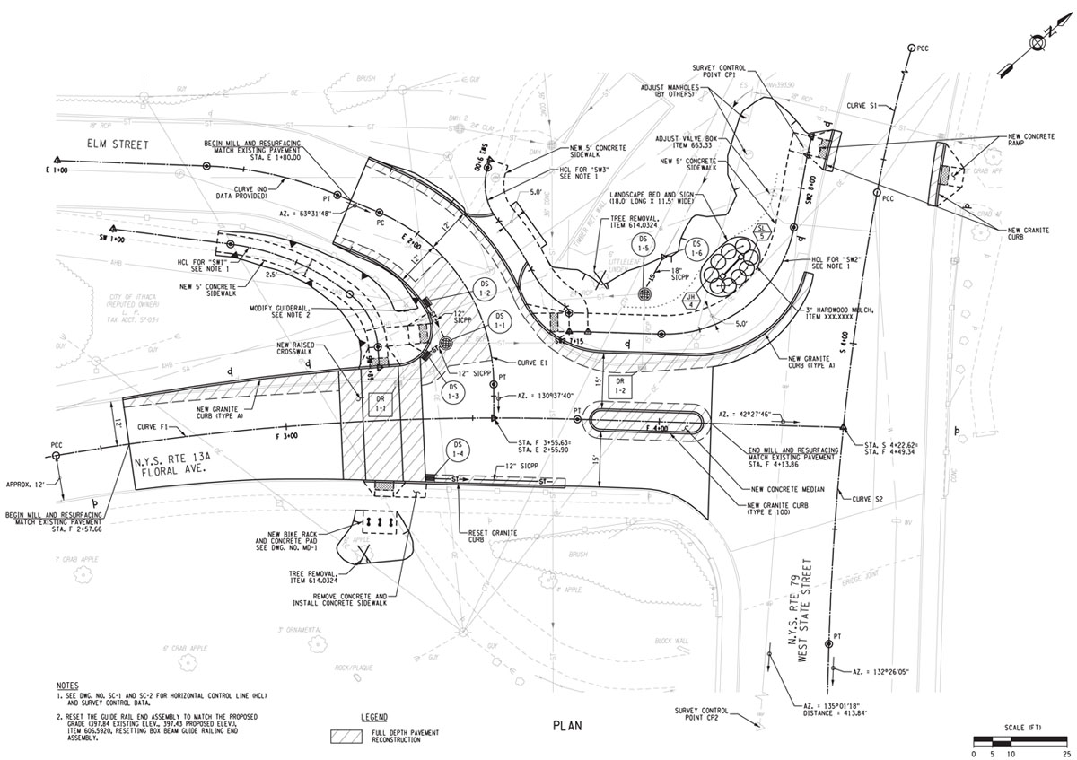
Contractual Aspects
Deliverables as part of the contract:
Safety Study Report
Design Plans
Cost Estimate
Specifications
Construction Schedule

Slide 15
Resources
 | Manpower
2.1 Safety Study Phase
2.1.1 Exist. Conditions Evaluation | 120 hrs
2.1.2 Proposed Improvements | 180 hrs
2.1.3 Benefit-Cost Analysis | 125 hrs
3.1 Design Phase
3.1.1 Plans | 240 hrs
3.1.2 Cost Estimate | 180 hrs
3.1.3 Specifications | 210 hrs
4.1 Construction Phase
4.1.1 Pre-construction | 350 hrs
4.1.2 Procurement | 280 hrs
4.1.3 Construction | 650 hrs

Slide 16
Preliminary Costs
 | Manpower | Unit Cost | Cost
2.1 Safety Study Phase
2.1.1 Exist. Conditions Evaluation | 120 hrs | $120.00 | $14,400.00
2.1.2 Proposed Improvements | 180 hrs | $120.00 | $21,600.00
2.1.3 Benefit-Cost Analysis | 125 hrs | $120.00 | $15,000.00
3.1 Design Phase
3.1.1 Plans | 1240 hrs | $120.00 | $148,800.00
3.1.2 Cost Estimate | 380 hrs | $120.00 | $45,600.00
3.1.3 Specifications | 210 hrs | $120.00 | $25,200.00
4.1 Construction Phase
4.1.1 Pre-construction | 250 hrs | $150.00 | $37,500.00
4.1.2 Procurement | 280 hrs | $150.00 | $42,000.00
4.1.3 Construction | 10650 hrs | $150.00 | $1,597,500.00
Total Cost |  |  | $1,947,600.00

Slide 17
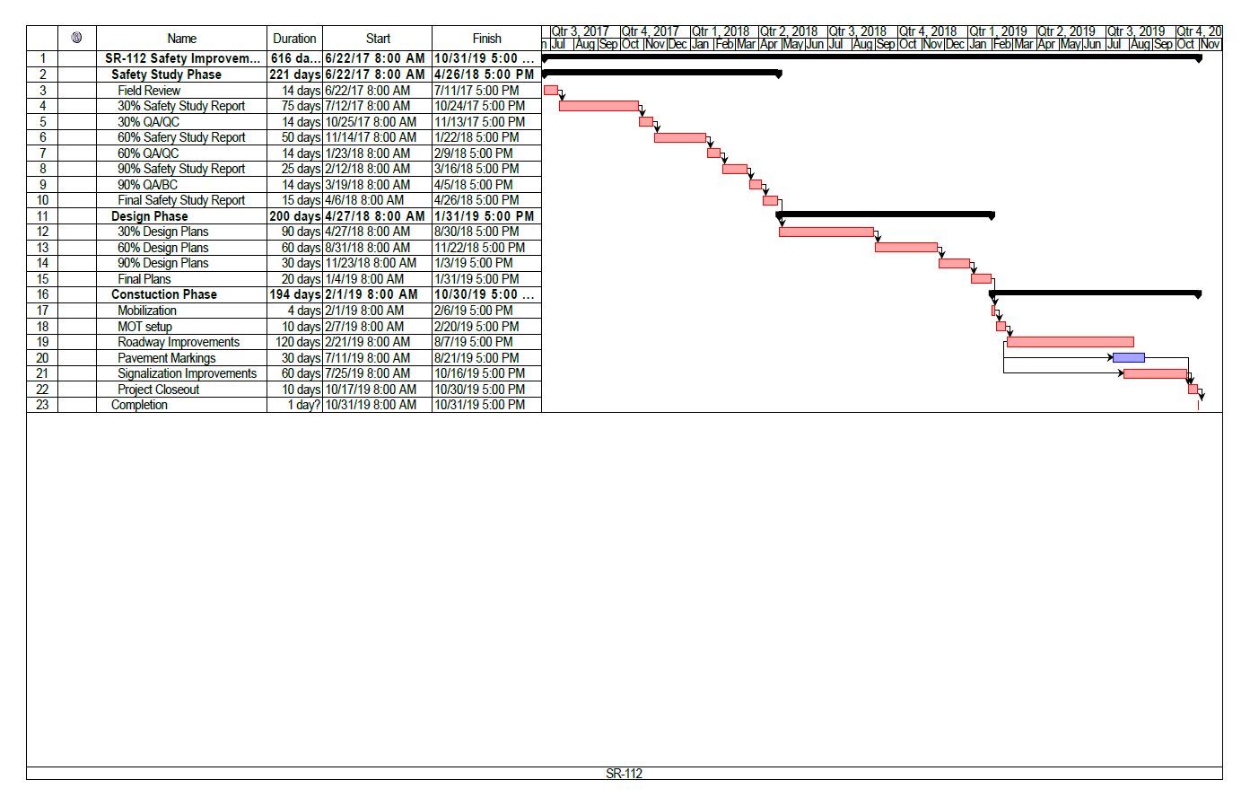
Schedule

Slide 18
Budget
 | Description | Budget
2.1 Safety Study Phase
2.1.1 | Exist. Conditions Evaluation | $15,000.00
2.1.2 | Proposed Improvements | $22,000.00
2.1.3 | Benefit-Cost Analysis | $15,000.00
 |  | Total: $52,000.00
3.1 Design Phase
3.1.1 | Plans | $160,000.00
3.1.2 | Cost Estimate | $46,000.00
3.1.3 | Specifications | $26,000.00
 |  | Total: $232,000.00
4.1 Construction Phase
4.1.1 | Pre-construction | $38,000.00
4.1.2 | Procurement | $43,000.00
4.1.3 | Construction | $1,650,000.00
 |  | Total: $1,731,000.00
Maintenance of traffic |  | $250,000.00
Mobilization |  | $123,000.00
Contingency |  | $380,000.00
Total Budget |  | $2,768,000.00

Slide 19
Personnel
Enmanuel Perez Project Manager
Shuai Xue Engineering Manager
Ziying Zheng
Design Manager
Yezehao Huai Construction Manager

Slide 20
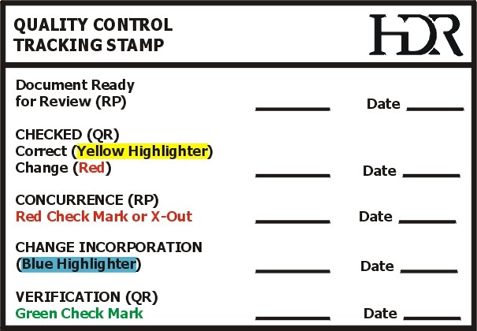

Evaluation Methods

Slide 21

Potential Problems
Weather and hurricane season
Groundwater Table Level
High Tourist Activity
Underground utilities

Slide 22

Questions?

